Slide 1
Mental health and wellbeing for people managers
Workshop materials for briefing session

Slide 2
Workshop materials – guidance for use
These slides can be used as basis for people professionals to train managers on mental health, specifically with reference to the potential mental health impact of COVID-19. Slides may be re-branded or adapted. Please note:
This session has been designed to be delivered as a briefing session with additional supplementary material for provision to delegates.
Please open slides in ‘notes’ view – speaker notes and references are included where appropriate. This includes additional material to explain each slide.
Update slides were indicated to reference organisation specific training, materials or support services.
Following the session distribute additional materials in the final slide for further reading and learning
Please note: these materials are provided for general information purposes and do not constitute legal or other professional advice. While the information is considered to be true and correct at the date of publication, changes in circumstances may impact the accuracy and validity of the information. The CIPD is not responsible for any errors or omissions, or for any action or decision taken as a result of using the guidance. You should consult a professional adviser for legal or other advice where appropriate.

Slide 3
Mental health and wellbeing for people managers
A briefing session

Slide 4
Session objectives
Summarise an overview of mental health including signs and symptoms
Highlight the manager role in supporting employee wellbeing
Provide guidance on having conversations about mental health
Support managers with further reading and resources

Slide 5
What is mental health?
Everyone has mental health and, like physical health, it fluctuates along a spectrum
Mental health varies from good mental wellbeing to severe mental health problems
A mental health problem is generally defined as when poor mental health continues for a prolonged period
There may or may not be a diagnosis of a specific condition. Common mental health conditions include depression, anxiety, phobias, obsessive-compulsive disorders and bipolar
Mental health problems affect around one in four people in any given year.
Notes:
Speaker notes – advise delegates that a significant number of people (more than 4 in 10) would not feel comfortable in disclosing stress or poor mental health to their employer or manager (CIPD research, 2016). People may feel that it will cause them to be treated differently, or are concerned it would harm their career opportunities.

Slide 6
Definition of mental health
World Health Organisation: ‘where each individual realises their own potential, can cope with the normal stresses of life, can work productively and fruitfully, and is able to make a contribution to their community’.
Notes:
Speaker notes: this is one definition of mental health.

Slide 7
From Mind, the mental health charity
Wellbeing is a dynamic mental state. Individuals with good mental wellbeing are able to:
Feel and express a range of emotions
Feel engaged with the work in general
Feel relatively confident in themselves and positive self esteem
Live and work productively
Cope with the stresses of everyday life
Adapt and manage in times of change and uncertainty
Notes:
Speaker notes: explain that this is another definition, and describes some of the what people with good mental wellbeing are able to do.

Slide 8
Common mental health conditions
Anxiety
Depression
Obsessive Compulsive Disorder (OCD)
Bipolar
Post Traumatic Stress Disorder (PTSD)
Eating disorders
Stress
Notes:
Speaker notes: delegates may wish to familiarise themselves with common mental health conditions: https://www.mind.org.uk/information-support/a-z-mental-health/
This may also be a helpful resource following a disclosure of poor mental health as it can help managers be more aware of conditions.
The most common mental health issues are depression and generalised anxiety.

Slide 9
Mental health absence
Mental health is a significant cause of absence from work
It is the most common cause of long-term sickness absence in UK
As well as sickness absence, poor mental health at work can lead to increased staff turnover, reduced engagement and high presenteeism.
A total of 12.8 million working days were lost because of work-related stress, anxiety and depression in 2018-19
This amounts to an average of 21.2 days lost per case
In 2018-19 mental health was the most common type of work-related ill-health, accounting for 44 per cent of all work-related illness
It is estimated that poor mental health costs UK employers £33bn–£42bn each year
Notes:
Speaker notes: this data is from the Labour Force Survey, analysed by the HSE https://www.hse.gov.uk/statistics/causdis/stress.pdf
Estimations of costs to employers is from Deloitte. However, it is also estimated by Deloitte that when companies spend £1 on mental health there is an average return of £5. https://www2.deloitte.com/uk/en/pages/consulting/articles/mental-health-and-employers-refreshing-the-case-for-investment.html

Slide 10
The law and mental health
Employers have a duty to protect the health, safety and welfare of their employees
This includes mental health and wellbeing
Employers have duties to assess the risk of stress-related poor mental health arising from work activities and take measures to control that risk
Mental health conditions may amount to a disability under the Equality Act 2010
Where an employee is disabled the employer must make reasonable adjustments to support them in the workplace
Adjustments will vary depending on the specific circumstances
Notes:
Speaker notes: prior to delivering the session speakers may wish to read CIPD guidance here:
Stress factsheet: https://www.cipd.co.uk/knowledge/culture/well-being/stress-factsheet
Disability factsheet: https://www.cipd.co.uk/knowledge/fundamentals/emp-law/disability-discrimination

Slide 11
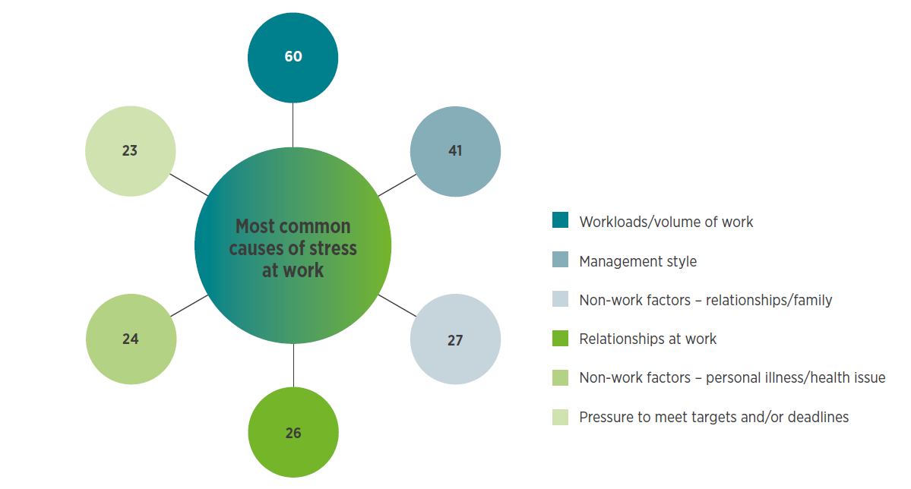
Causes of poor mental health at work
Workload
Relationships
Working hours
Job demands
Work life balance
Control
Organisational change
Individual factors, e.g. personality, self-confidence, resilience
Notes:
CIPD graph – page 26 https://www.cipd.co.uk/Images/health-and-well-being-2020-report_tcm18-73967.pdf

Slide 12
Stress at Work
Definition of work related stress: the adverse reaction that people have to excessive pressures or other types of demand placed on them at work. (HSE)
Notes:
Speaker notes: this definition relates to stress at work. Work is just one source of stress. Stress may also come from a range of factors including relationships, family problems, acute life events such as bereavement, divorce, accident or the ill-health of others. Stress may also be influenced by individual and personal factors
Current causes of stress may also include caring for family members, isolation, fear of ill-health, home-schooling or working in jobs that are specifically dealing with first line response to the pandemic.
It is important to note that stress is a response to a situation, and not the situation itself. So therefore employees will have very different stress responses to the pandemic.

Slide 13
Causes of Stress
Demands - this includes issues such as workload, work patterns and the work environment
Control – how much say the person has in the way they do their work
Support – this includes the encouragement, sponsorship and resources provided by the organisation, line management and colleagues
Relationships – this includes promoting positive working to avoid conflict and dealing with unacceptable behaviour
Role – whether people understand their role within the organisation and whether the organisation ensures that they do not have conflicting roles
Change – how organisational change (large or small) is managed and communicated in the organisation
Notes:
Speaker notes: HSE has identified six key areas (or ‘risk factors’) that can be causes of work related stress. Other factors may include career development - : the extent to which the organisation provides opportunities for promotion, skills development and job security, as well as the work–home interface - the extent to which individuals are able to balance the demands of work and home.

Slide 14
Possible health implications of COVID-19
Overwhelm
Anxiety
Low mood
Depression
Poor sleep / fatigue
Grief
Anger / irritability
Distraction
Poor diet / reduced exercise
Musculoskeletal
Substance misuse
Notes:
Speaker notes:
The full impacts on health are not yet know. Early research suggests some of these factors. Information taken from IES Survey on working from home during lockdown, research from the University of Manchester and a rapid evidence review of other quarantine situations such as Ebola and SARS.
Mental health impacts could last for some time – they may also include fear and anxiety relating to the return to work.

Slide 15
Indicators of poor mental health
Physical | Psychological | Behavioural
Fatigue Headaches Change in sleep pattern Sweating / constantly feeling cold Appetite or weight changes Digestive problems | Anxiety or distress Mood changes Feeling low Indecision Loss of motivation Distraction or confusion Irritability Loss of humour Increased sensitivity Tearfulness Lapses in memory Difficulty relaxing | Increased smoking and drinking Substance misuse Withdrawal Resigned attitudes Restlessness Increased sickness absence Uncharacteristic errors Intense or obsessive activity Risk taking Working longer hours Disruptive or anti-social behaviour Irritability, anger or aggression Inconsistent or impaired performance
Notes:
Speaker notes: These indicators do not necessarily mean that someone has a mental health condition. Every person is different. They should be treated only as indicators that should prompt a conversation about wellbeing and mental health.

Slide 16
The role of the manager
Managing absence or ill-health:
Return to work meetings
Phased returns
Applying organisational policy and process
Making reasonable adjustments
Referrals to Occupational Health
Enabling wellbeing and good mental health:
Managing workloads
Being a good role model
Spotting signs
Wellbeing conversations
Encouraging wellbeing activity at work
Tackling poor habits (long hours working, lack of rest)
Notes:
Speaker notes: where necessary include a summary of organisational policy relating to absence management.
These are management tasks that can address both managing mental health when an employee is ill and absent, as well as taking early intervention and preventative steps. Remind delegates that early intervention with mental health can be critical; always consider prompt referral to support services before the situation escalates.

Slide 17
Wellbeing Conversations
Managers may wish to use some of these prompts and questions in wellbeing conversations
How are you?
How are you feeling?
I have noticed....
What support do you need?
What do you need from me right now?
How are you finding your current workload?
What challenges are you dealing with?
Notes:
Speaker notes: remind delegates about the difference between open and closed questions, and the importance of listening.

Slide 18
Responding to disclosures
Avoid making assumptions
Maintain confidentiality
Ask
Develop a support action plan
Encourage them to seek support
Signpost
Reassure
Notes:
Speaker notes: Advise managers to consider:
Choosing a suitable time and place for the conversation. If it needs to take place remotely or online this is fine. Ensure they will not be disturbed.
Remember! Many people are able to manage their condition and perform their role to a high standard. Avoid guessing what symptoms they might have or what support they will need.
Discuss with the employee what (if any) information they are able to share. If you want to take advice, perhaps from HR, ask the person if you can share any information you have been provided. Remember your obligations under data protection legislation.
Ask people what they need and consider writing up a support plan (more information will follow in later slides)
Include a review of any plan – keep it up to date.
Encourage people to get support from either your internal or external services – provide contact information where possible.
Make sure the employee knows you will support them and how to ask for help.
Seek more advice yourself if you need it, from HR or Occupational Health.

Slide 19
Recommendations for people managers
Check in regularly with employees – ideally face to face and weekly
Look for possible signs and symptoms of poor mental health
Tackle unhealthy working habits
Raise concerns about poor mental health with the employee
Proactively review workloads
Signpost to support services
Promote wellbeing opportunities
Undertake wellbeing action plans
Review your own management style
Keep in regular contact and review support where it is provided
Notes:
Speaker notes:
Points 1 – remind managers that they may wish to ask employees how best to keep in contact – face to face contact even online can help managers to spot non verbal signals about wellbeing and mental health – but try and provide the individual with choice.
Points 2 – as discussed earlier in the briefing
Point 3 – this may include long working hours, unhealthy email cultures or conflict in teams.
Point 4 – follow the advice provided in the slide on wellbeing conversations
Point 5 – workload is the main reason people take absence for stress, anxiety and depression. In the current situation it is more important than ever to review workloads – ensure that they are reasonable and adjusted where necessary. This can form part of the discussion in point 1.
Points 6, 8 and 9 - more information will follow on each of these.
Point 7 – be sure to familiarise yourself with the wellbeing offering of the organisation
Point 9 – managers who wish to assess their competence on managing stress can complete this self-assessment from HSE: https://www.hse.gov.uk/stress/mcit.htm
Point 10 – agree with the employee how often to have a review meeting

Slide 20
Support
Phased return to work (following sickness absence)
Temporary or permanent flexible working arrangements, for example reduced hours or remote working (even after we return to ‘normal’)
Changes to duties – temporary or permanent
Time off for medical treatment
Buddying, coaching or mentoring
More regular rest periods
Additional management support
Change to start and finish times
Notes:
Speaker notes: the support that may be required for an employee experiencing poor mental health will vary according to their job, personal situation and their specific condition and symptoms. These are just some examples. Remember that if the employee is disabled for the purposes of the Equality Act, there may be a duty to make these adjustments.
Remind managers to keep a record of changes made and support provided.

Slide 21
Wellbeing action plans
Managers can use these questions to put together a formal plan for supporting employees with their wellbeing and mental health:
What helps you to stay mentally healthy at work?
What can your manager do to proactively support you to stay mentally healthy at work?
Are there any situations at work that might trigger poor mental health for you?
Are there any warning signs that we might notice if you were experiencing poor mental health?
If we notice early warning signs, what should we do?
What steps can you take if you start to feel mentally unwell at work – and can we do anything to facilitate them?
Notes:
Speaker notes: these questions are based on wellbeing action plan from Mind. They can be downloaded here: https://www.mind.org.uk/workplace/mental-health-at-work/taking-care-of-your-staff/employer-resources/wellness-action-plan-download/ (included in resources list in final slide).
These can be used for a conversation or to put together a written support plan.

Slide 22
Support services and resources
External:
Samaritans: 116 123
NHS: 111
Shout text crisis service: 85258
If someone’s life is at risk: 999
Internal:
[insert organisational services, e.g. EAP, Occupational Health]
[insert organisational wellbeing information or activity]

Slide 23
Additional learning resources for managers
CIPD and Mind – People Managers’ Guide to Mental Health
CIPD President Professor Sir Cary Cooper on the role of people managers and wellbeing
Evidence on interventions to support wellbeing from the New Economics Foundation: 5 Ways to Wellbeing, 2008
Mind on supporting yourself and your team
CIPD – Managing stress through positive management behavior:
ACAS – approaching sensitive conversations about mental health
Mind – Wellbeing Action Plan download

